Slide 1
CRICKET PLAYER APPLICATION
Build by: Group 3(Batch 62 Java FSD)
Ujjwal Gupta
Gouri Balkrishna Shinde
Mohamed Thanveer V H
Shaik Mahammad Bara Shaheed
Under the Guidance of:
Mr. Vikram Verma

Slide 2
OUTLINE:
Introduction
Problem Statement
Objective
Microservices
Project Overview
Architecture
Application Flow
Snapshots of the Application
Technology and Tools Used
Conclusion

Slide 3
INTRODUCTION:
The Cricket player application provides all information about the Cricket Players.
It also shows the statistics of the players at various formats and their recommendations from different countries.
One can add them to favourites and can create a list of their beloved players.
We can see the interactive UI where user can register themself, login with there userId and one can also search the player by just typing their name in the search bar provided.

Slide 4
PROBLEM STATEMENT:
Basically the task of our project is to build a Cricket player application to search cricket players and add them to the favorite list. Also we wish to create a Dashboard view with three sections to display all the Favorite under Favorite section, display the detailed statistics of every player and view all players recommendations from 3rd party tracks service provider.

Slide 5
OBJECTIVE:
The Main objectives of project are as follows:
View All Favorite players under Favorite section
Display all Player statistics under Player statistics section
View all players recommendations from 3rd party tracks service provider under recommendations section

Slide 6
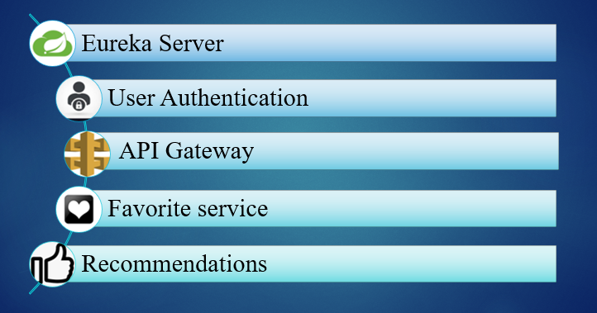
MICROSERVICES:

Slide 7
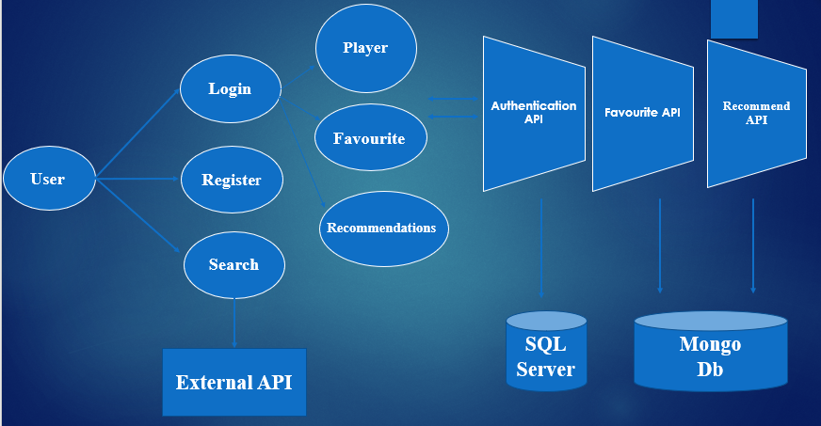
PROJECT OVERVIEW:

Slide 8
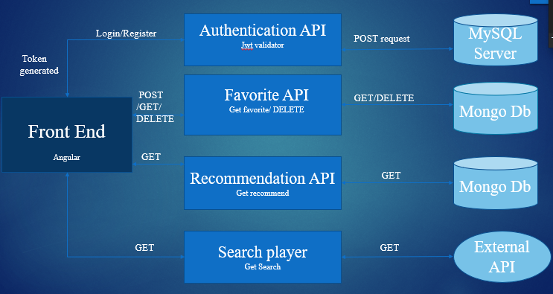
ARCHITECTURE:

Slide 9
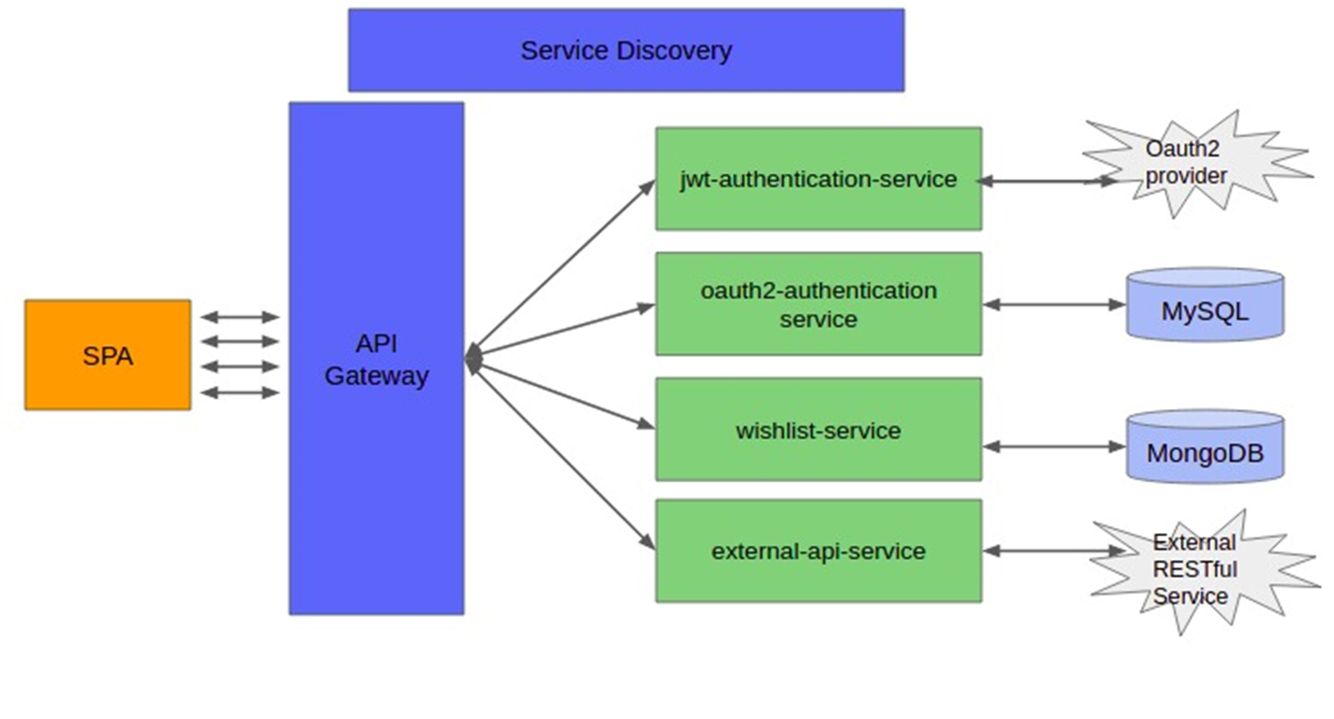
HIGHER LEVEL ARCHITECTURE DIAGRAM

Slide 10
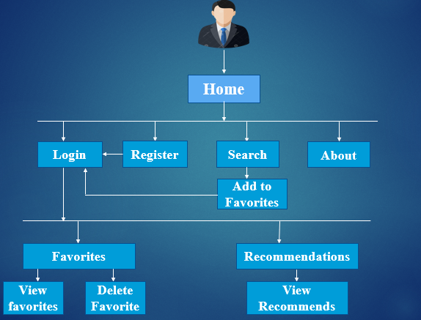
APPLICATION FLOW:

Slide 11
SNAPSHOTS OF THE APPLICATION

Slide 12
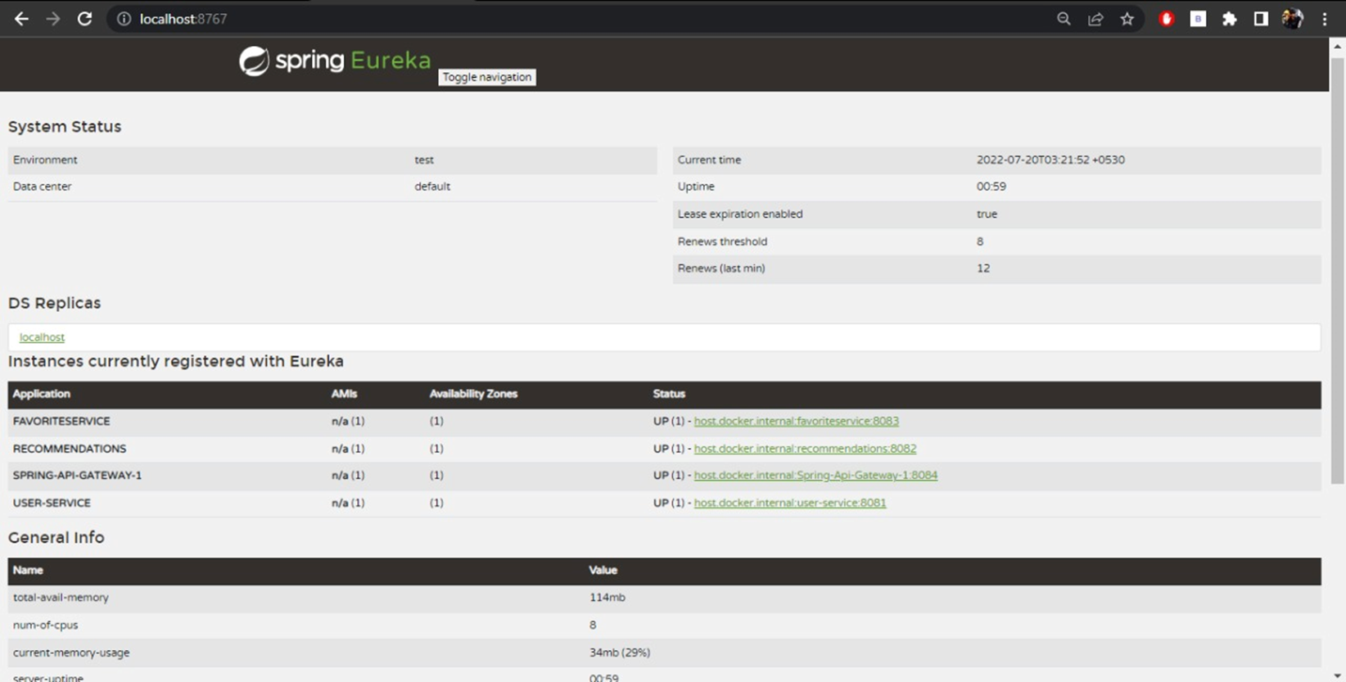
EUREKA SERVER

Slide 13
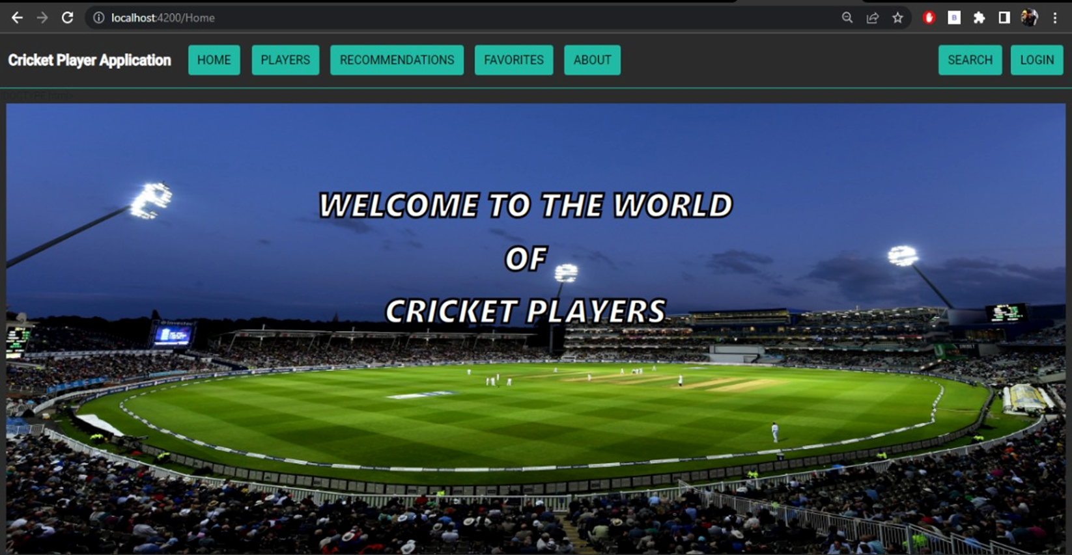
HOME PAGE

Slide 14
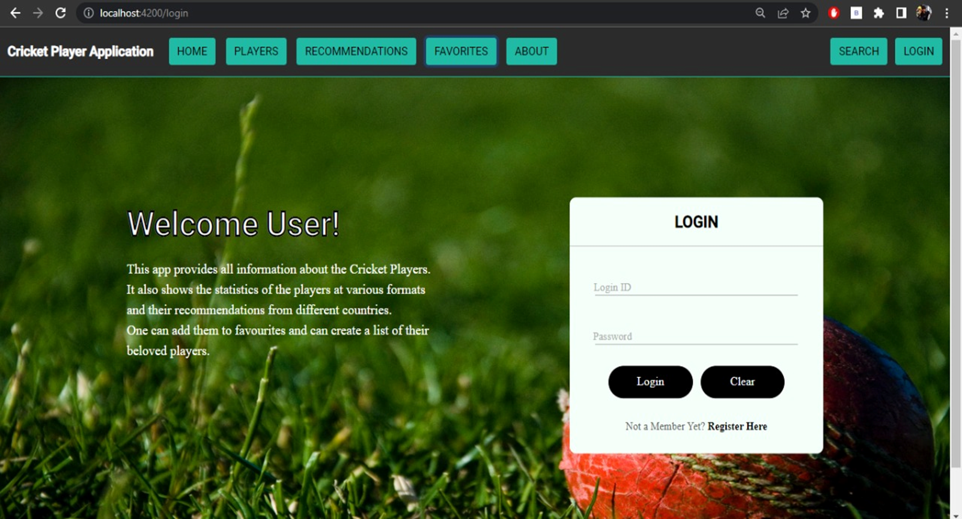
LOGIN PAGE

Slide 15
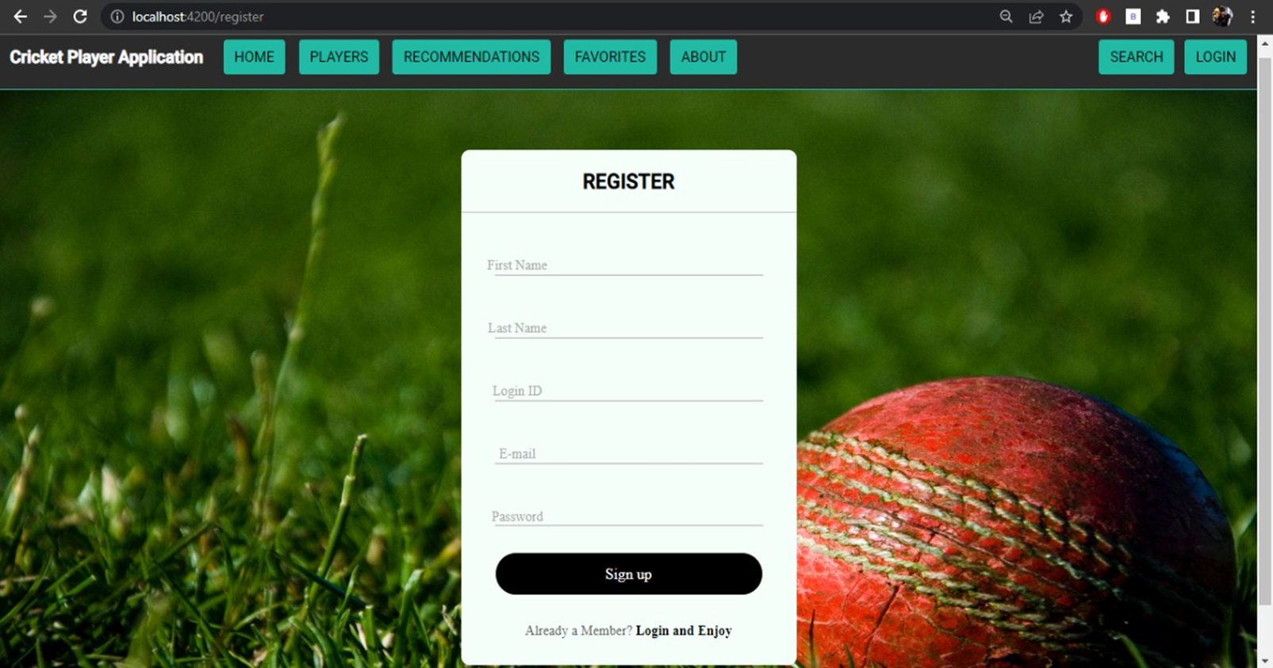
REGISTRATION PAGE

Slide 16
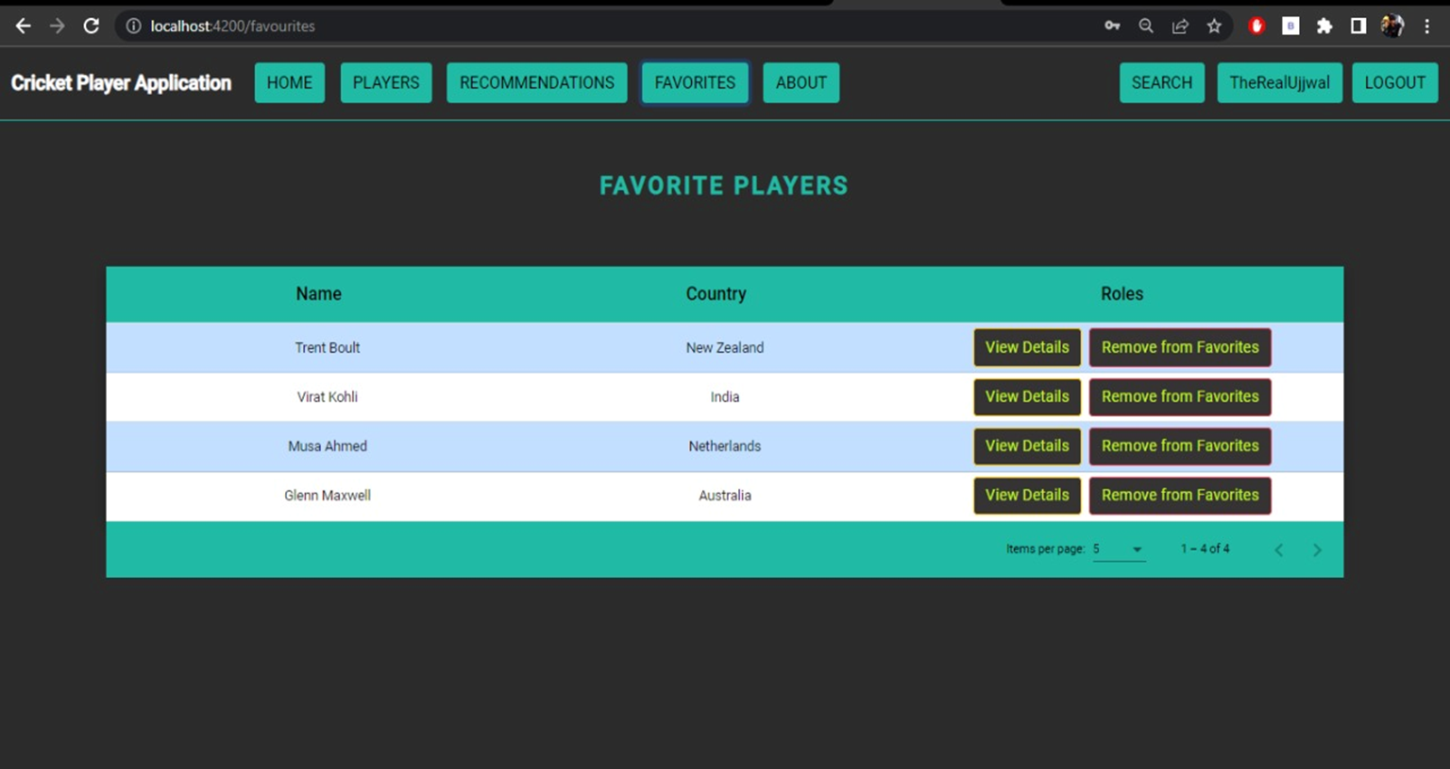
FAVORITE SECTION

Slide 17
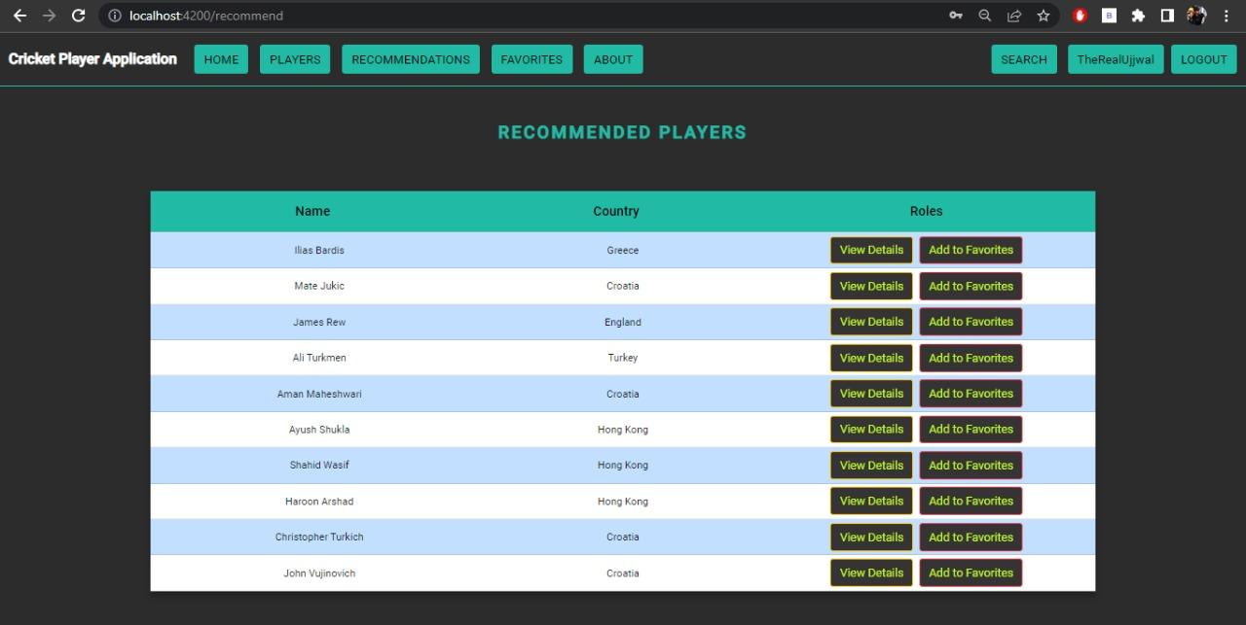
RECOMMENDATION

Slide 18
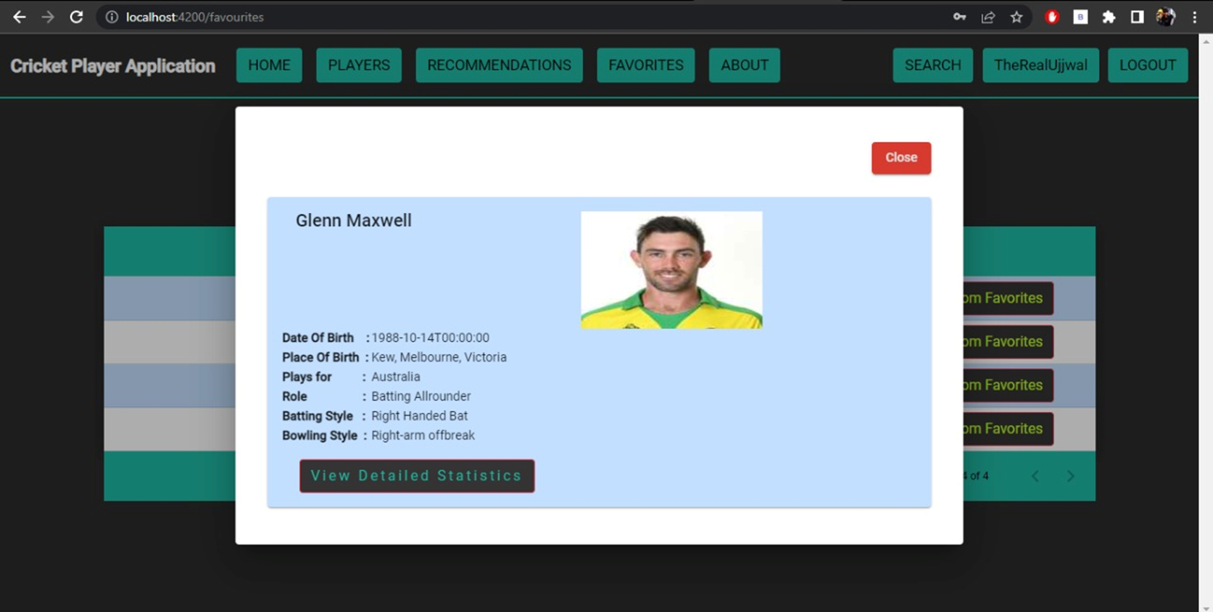
PLAYER STATISTICS

Slide 19
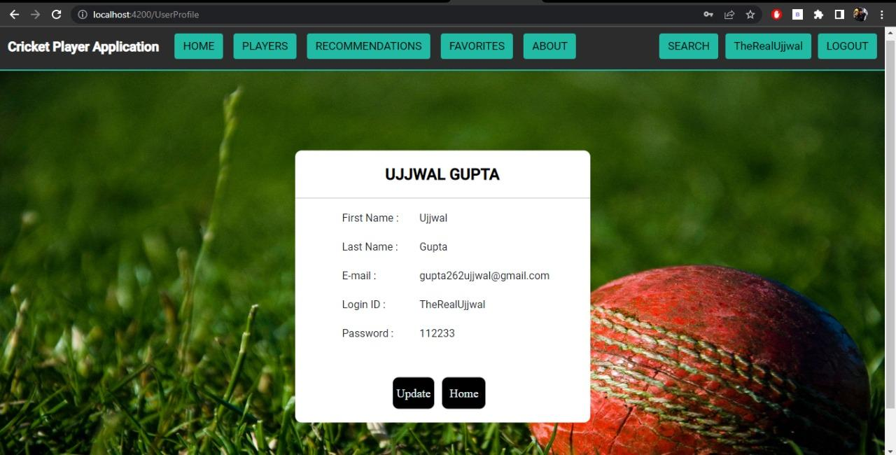
PROFILE AMENDATION PAGE

Slide 20
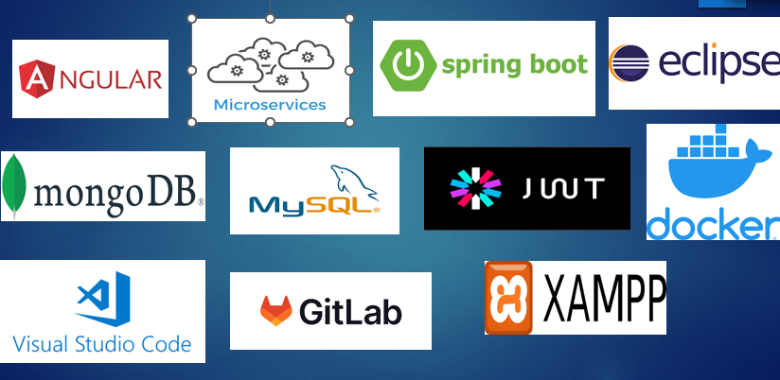
TOOLS AND TECHNOLOGIES:

Slide 21
CONCLUSION:
As shown in the slides till now, we have implemented everything that was mentioned in the objectives of the project.
Here the user is able to Register, Login, and Logout with the help of the JWT Authentication.
The user is able to Search the cricket players and add them into favorite section. This is achieved with the help of external API and microservices that we have used in the project.
The application also recommends the Cricket players to the user and this was achieved using microservices and the database.
So to conclude, our Cricket Player Application is satisfying every feature that was mentioned.

Slide 22
THANK YOU

